Slide 1
Data Access Services D.4.6
Renee OBREGON, AKKODIS
Notes:
The MobiDataLab Transport Cloud is a prototype platform for sharing transport data which makes it accessible to mobility actors.
In particular, the aim of the Transport Cloud is to make mobility data Findable, Accessible, Interoperable and Reusable
To showcase that the project meets these four objectives, four demonstrators have been prepared as part of the prototype implementation of the WP4.
One of these is the Reference Data Catalogue, which was based on an inventory of datasets and data portals covering several categories of datasets related to the use case challenges proposed during the living and virtual labs.
These were catalogued into the MobiDataLab GeoNetwork and CKAN metadata catalogues that will be presented.
Findable – allowing the discovery of data, either static or dynamic
Accessible – providing access to mobility data
Interoperable – prototyping data processors for adding value to the data
Reusable – demonstrating anonymisation and privacy-preserving tools

Slide 2
Access via QGIS
Access mobility data and learn about available basic tools.

Slide 3
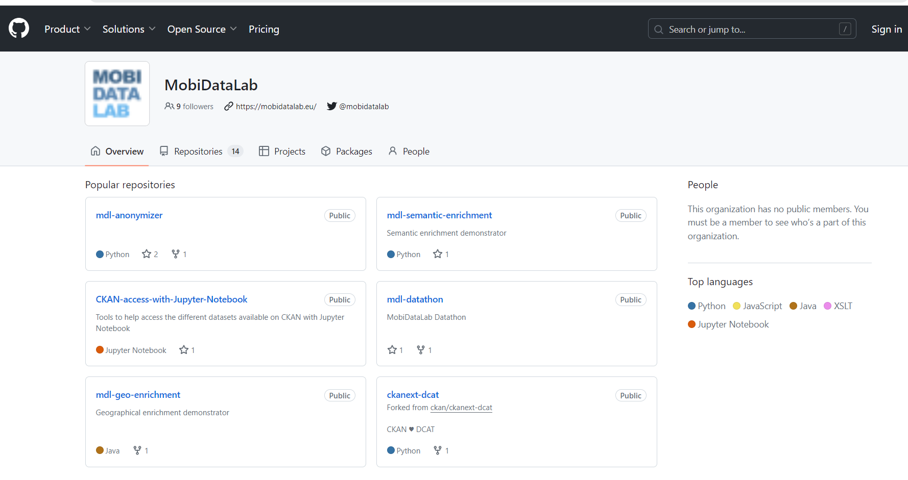
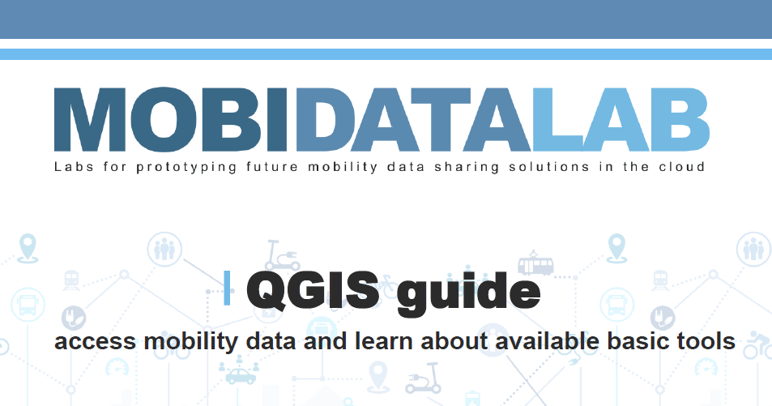
GitHub: https://github.com/MobiDataLab
QGIS guide
Guide to access mobility data and learn about available basic tools on QGIS. It provides information about how to access the CKAN and the GeoNetwork catalogues of MobiDataLab.
Notes:
https://github.com/MobiDataLab/QGIS-guide-CKAN-GeoNetwork-access

Slide 4

QGIS
QGIS is a user-friendly Open Source Geographic Information System (GIS) that runs on Linux, Unix, Mac OSX, and Windows. QGIS supports vector, raster, and database formats. QGIS is licensed under the GNU General Public License. QGIS lets you browse and create map data on your computer. It supports many common spatial data formats (e.g. ESRI ShapeFile, GeoTIFF). QGIS supports plugins to do things like display tracks from your GPS. QGIS is free of cost.
Notes:
QGIS is a user-friendly Open Source Geographic Information System (GIS) that runs on Linux, Unix, Mac OSX, and Windows. With Qgis we can also discover and create map data.
It supports many common spatial data formats, and we can do multiple types of data analysis.

Slide 5
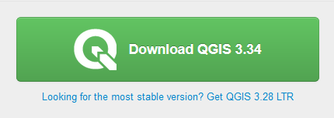
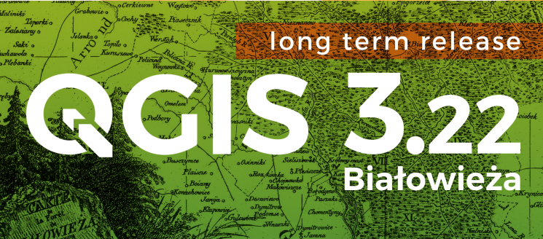
QGIS Installation
Download QGIS
(it is recommended to select
the long-term release :
currently 3.28 LTR)
Follow the installation instructions
Launch the program
QGIS DESKTOP 3.28

Slide 6

Catalogue Services for the Web (CSW) & GeoNetwork access

Slide 7
MetaSearch
MetaSearch is a QGIS plugin to interact with metadata catalogue services, supporting the OGC Catalogue Service for the Web (CSW) standard. MetaSearch provides an easy and intuitive approach and user-friendly interface to searching metadata catalogues within QGIS.
Notes:
The Metasearch is a tool for the discovery of data.

Slide 8
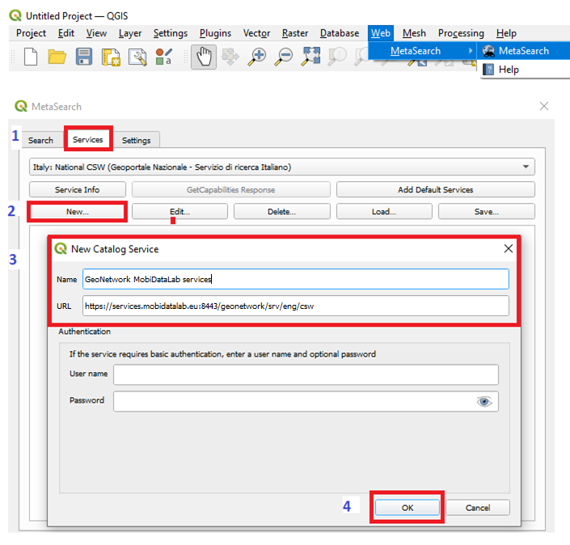

Qgis built-in tool for MetaSearch
Launch the MetaSearch tool
Consult the “Web Menu” (on top of the Qgis menu) and select MetaSearch and then MetaSearch again.
Add the Catalog Web Service (CWS)
Click on the “Services” tab
Click on “New”
Add the CWS URL (https://geonetwork.mobidatalab.eu/GeoNetwork-4.0.5-0/srv/eng) on the “Service” tab, assign a name to the portal and save it.
Click on “OK”
Notes:
To start MetaSearch, click the icon or select Web ► MetaSearch ► MetaSearch via the QGIS main menu. The MetaSearch dialog will appear. The main GUI consists of three tabs: Services, Search and Settings.
The Services tab allows the user to manage all available catalogue services. MetaSearch provides a default list of Catalog Services, which can be added by pressing the Add Default Services button.
To find all listed Catalog Service entries, click the dropdown select box.

Slide 9

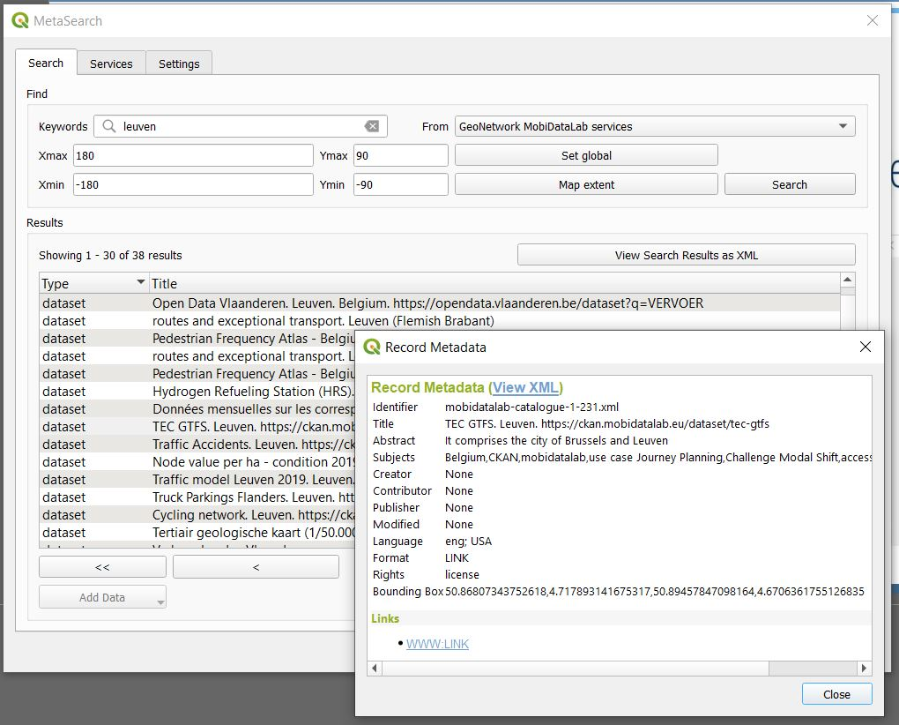
Search for Metadata
To search for specific keywords (type them on the search bar and click on search) or to see all the available datasets on the portal (leave the search bar empty and click on search).
To filter your data on a particular area of the world, change the map coverage according to the area on which your QGIS project is focused with the button “map extent” or access the metadata all over the world by using the “set global” button.
It is possible to download the results as XML.
When selecting a service or a dataset, it is possible to get the metadata record, which provides the link to access the source of the data.
If the service or the dataset is in the right format to be read by QGIS, it will be possible to load the data.
Notes:
The Search tab allows the user to query Catalog Services for data and services, set various search parameters and view results.
You can enter Keywords to start your search or leave empty the search bar and click on search to see all the available datasets on the portal
Select the Catalog Service in which you wish to perform the query against;
You can use the bounding box to limit or filter data on a spatial area of interest and change the map coverage according to the visible area on which your QGIS project is focused with a click on “map extent”(you can enter the values manually) or If you prefer to do a global search, Click on “Set Global”.
To give you an example, if we search for Leuven, it will be possible to open the metadata of the dataset by doing a double click. This information is the same that is displayed in GeoNetwork or CKAN. In this case, CKAN as we were redirected directly to the catalogue containing the link to download the dataset.

Slide 10
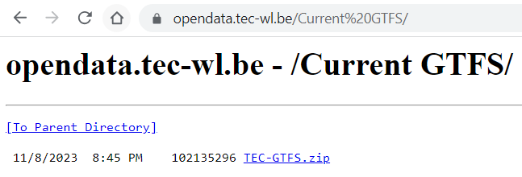
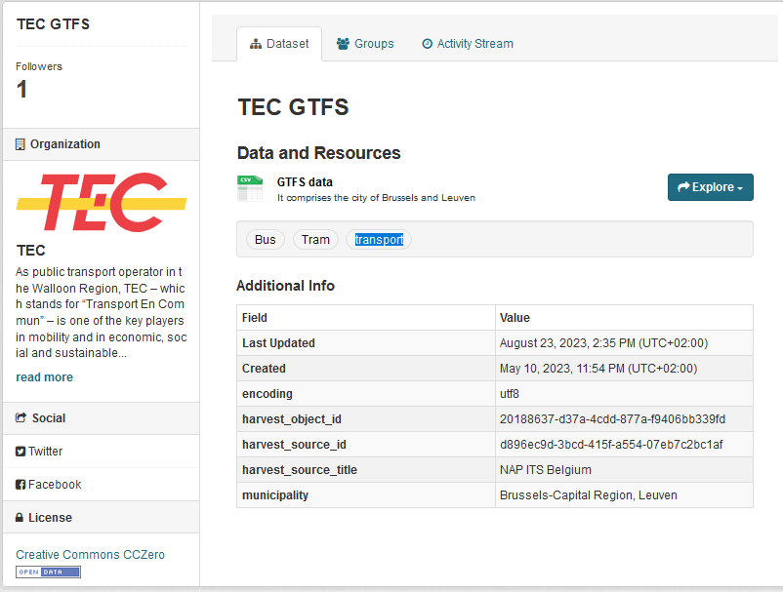
Example TEC dataset
Notes:
To give you an example, when searching for Leuven, the metadata of the dataset can be consulted by doing a double click.
This information is the same that is displayed in GeoNetwork or CKAN.
In this case, CKAN, since we were redirected directly to the catalogue containing the link to download the dataset.
There are different ways to load a dataset.

Slide 11
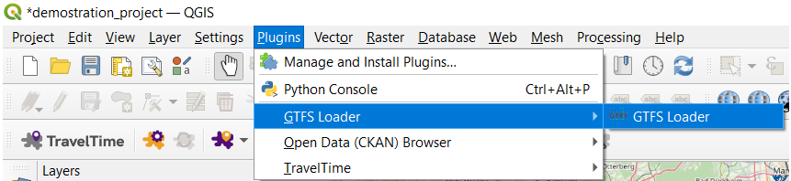
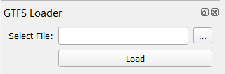
GTFS Loader plugin
Via the “Plugins” Menu, install the GTFS Loader plugin
Open the plugin by going to the plugins Menu
Search for the folder containing a GTFS file
Load the file
Notes:
To add the GTFS downloaded into the project, you can use the plugin called “GTFS loader”
Since a link to download a GTFS dataset was obtained, it can be added to the project with a plugin called “GTFS loader”
The first step is to :
Search for the folder containing the GTFS file downloaded and then
Load the file

Slide 12

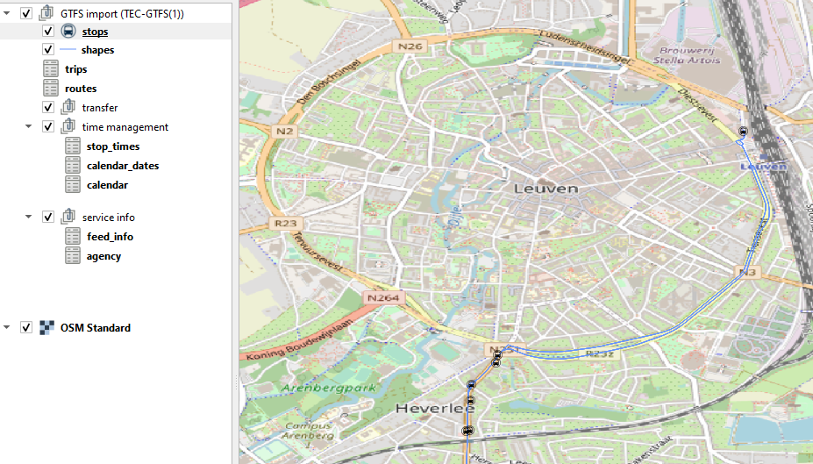
Notes:
After a couple of seconds or minutes, it will display the different text and spatial files available. For example, the stops and shapes of the public transport organization TEC in Leuven.
It is quite simple to use the metasearch. Supported resources like Web Mapping or Web Features Services data sources can be loaded directly in QGIS without intermediate steps, by clicking on add data.
For instance, there is a service which contains the bike lanes around Leuven, which are the yellow, orange and green lines visible on the map. A parking layer was also available.

Slide 13
The Search tab allows the user to query Catalog Services for data and services, set various search parameters and view results.
Notes:
When searching for a dataset, the Search tab allows the user to query Catalog Services for data and services, set various search parameters and view results.
You can enter Keywords to start your search.
Select the Catalog Service in which you wish to perform the query against;
You can use the bounding box to limit or filter the spatial area of interest (you can enter the values manually) or
If you prefer to do a global search, Click on Set Global or
To search in the visible area of your current map, click on Map Extent.

Slide 14
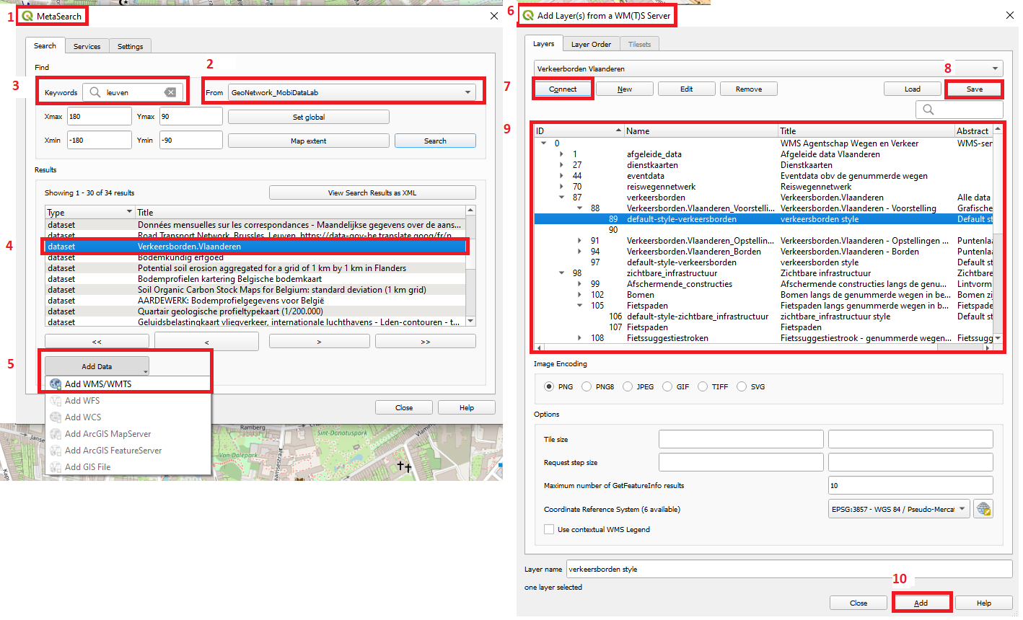
Add a WMS/WMTS via the Metasearch
Open the Metadata search
Select the desired CSW
Search for a keyword
Select a dataset in WMS/WMTS format
Add data
On the layer from WMTS Server
Connect
Save it (optional)
Select it
Add it

Slide 15
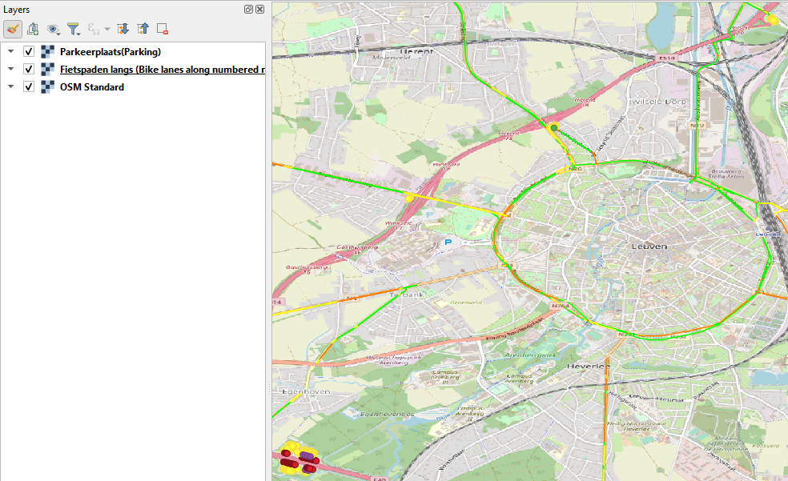
WMS of bike lanes around and parking around Leuven

Slide 16
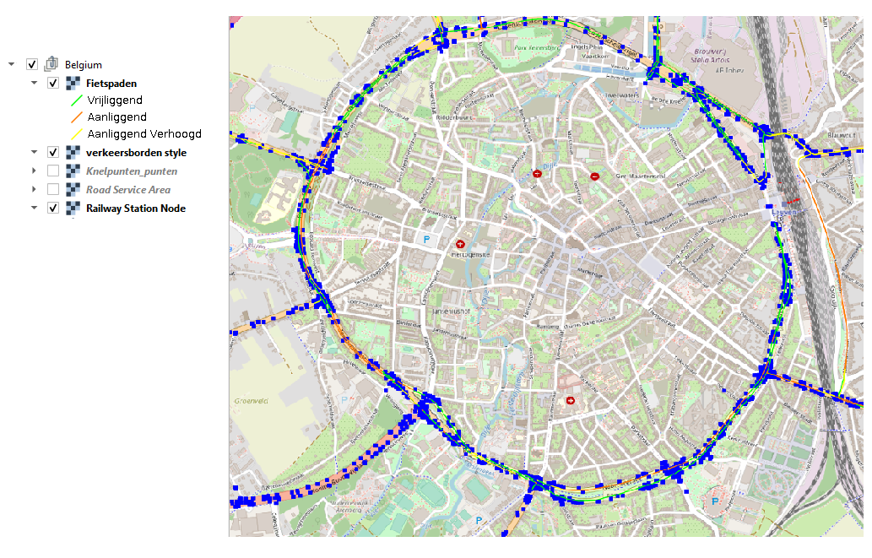
WMS of bike paths, road signs and railway nodes around Leuven

Slide 17
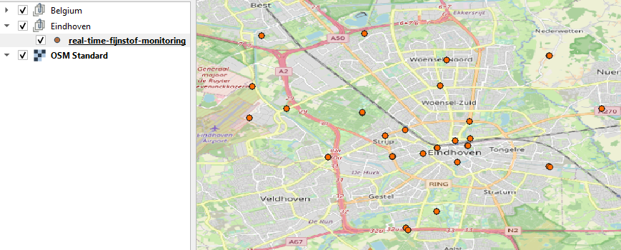
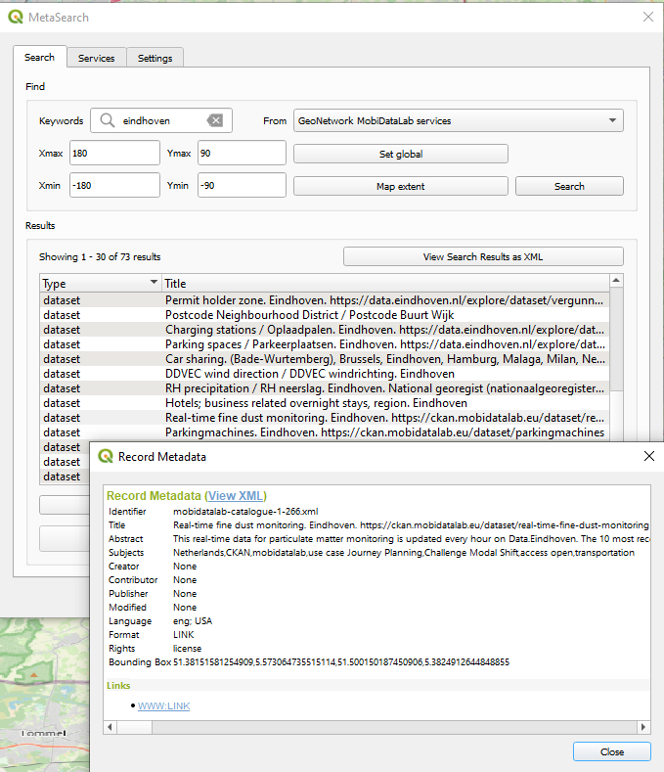

Slide 18

Access CKAN metadata catalogue
CKAN plugin
Notes:
Moving into the CKAN plugin, this can be installed

Slide 19
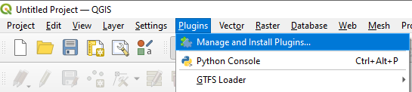
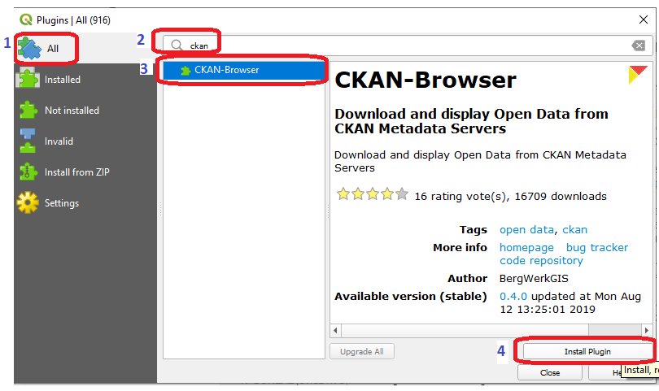
CKAN browser plugin installation
Do a left click on the “Plugins” menu (on the QGIS menu bar)
Select “Manage and Install Plugins”
Search for the CKAN-Browser
Install the plugin
Notes:
To install the CKAN plugin it is necessary to go to the “Plugins” menu (on top the Qgis menu bar) and select “Manage and Install Plugins” and search for the CKAN-Browser plugin and click on install.

Slide 20
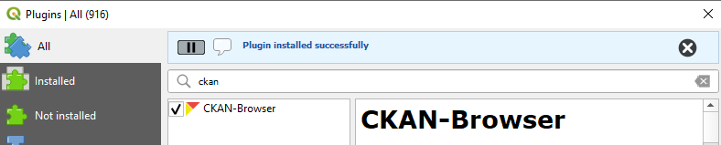
Ckan browser plugin installation

Slide 21
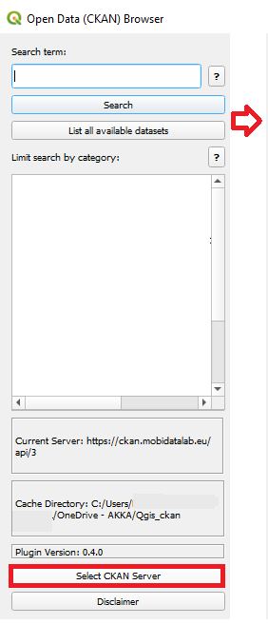
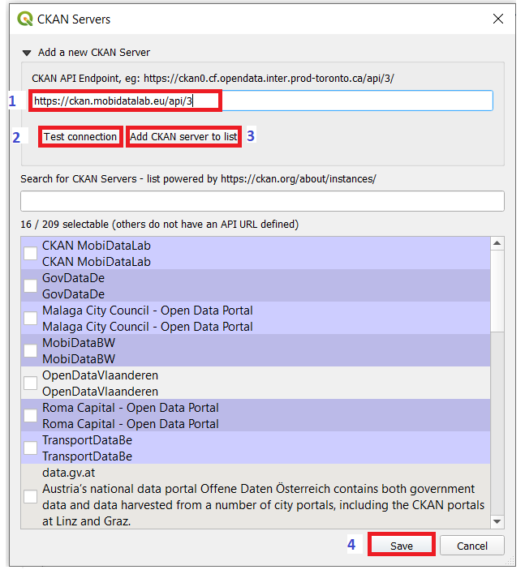

Find and access available metadata on CKAN
Launch the CKAN Browser
Clicking on the CKAN icon (on the QGIS toolbar)
Select “CKAN Server”
Enter the URL of the CKAN instance (in this case https://ckan.mobidatalab.eu/api/3/).
Test the connection, to make sure that the right URL was used
If the connection was successful, add it to the CKAN server list. Otherwise verify the URL entered before.
Save the link to the server on the list.
Notes:
To browse and access the CKAN metadata, it is necessary to click on the CKAN icon that appears of the Qgis toolbar and enter the URL of the CKAN instance (in this case https://ckan.mobidatalab.eu/api/3/) to add to the Qgis CKAN servers list (see Figure 14). By default, there are some CKAN portals already on the list. To verify that the right URL was entered, the connection can be tested. If the connection is successful, it’s possible to save the link to the server on the list to find quickly when using the plugin.

Slide 22
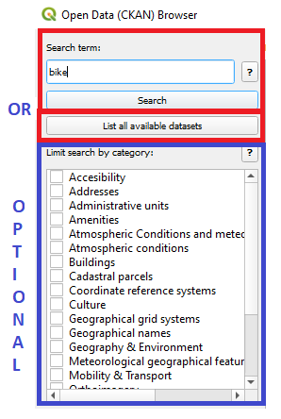
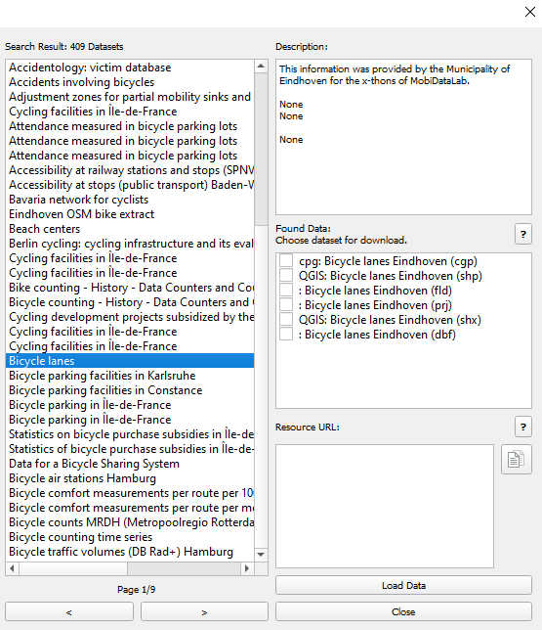
Download and display Open Data
Search for a particular term or for all the datasets available on CKAN.
The categories assigned on CKAN can be found here as well, to filter the datasets according to the CKAN group categories. When selecting a particular dataset, the description and the format will be showed on the right boxes.
When the datasets are in a format that can be read directly by QGIS, it will be possible to select them and load them. Otherwise, there is often the possibility to download the data to consult it by other means.
Notes:
The next step is to select the desired CKAN instance and start searching for a particular term or for all the datasets on the instance (by leaving the search box blank and just clicking on the list of all the available datasets).
Datasets can be discovered and filtered through categories (also known as groups on the CKAN interface) proposed on the left side or by selecting one or more of these categories.
However, it is important to mention that not all the datasets have been assigned to these categories.
When selecting a particular dataset, the description and the format will be shown in the right boxes.
As with the metasearch, when the datasets are in a format that can be read directly by QGIS, it will be possible to select them and load them.
Otherwise, there is often the possibility to download the dataset and load it by other means.

Slide 23
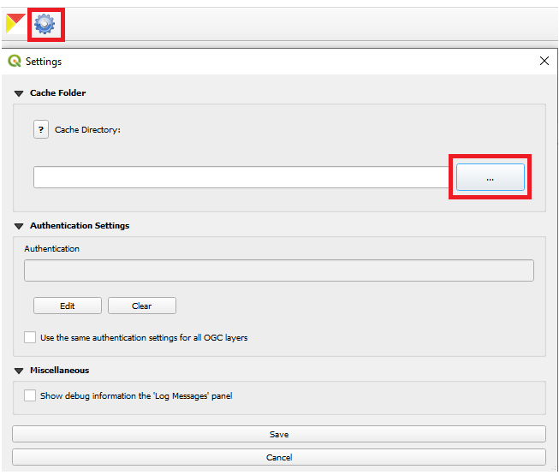
Save the downloaded datasets
Go to the CKAN plugin settings
Create or select a folder “cache directory” where the downloaded data will be stored.
Save
Notes:
When the datasets are in a format that can be read directly by QGIS, it will be possible to select them and load them.
Otherwise, there is often the possibility to download the data to consult it by other means.
To save downloadable datasets, it is necessary to create a folder “cache directory” where it will be easy to find them.
This can be set by going to the CKAN plugin settings (which is the wheel icon).
To add or access a web service manually after finding a link in the browser,
the connection can be established by going to the “Layer” Menu, selecting “Add layer” and selecting the type of layer to be added.

Slide 24
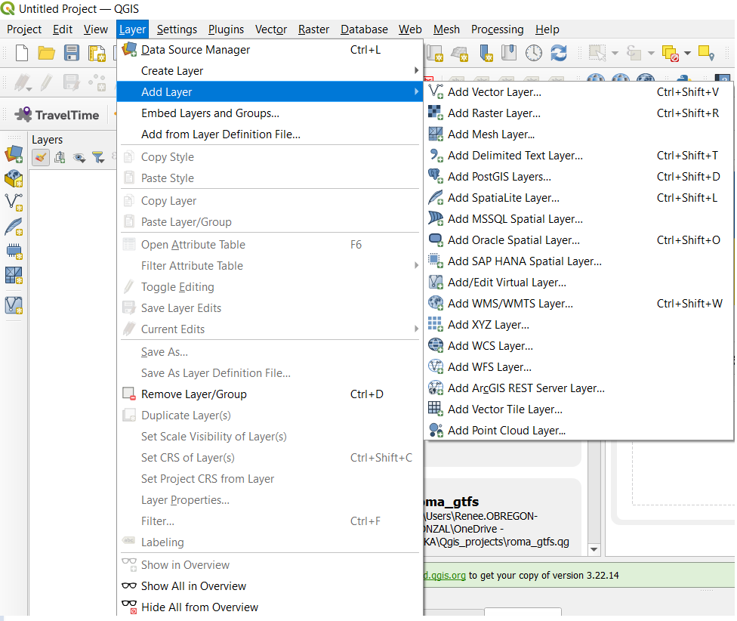
Add a layer to QGIS or connect to a web service
To add or access a web service layer on QGIS manually, it is possible to connect to it via the “Layer” Menu “Add Layer”.
Notes:
To get more information about the steps to follow to add different data formats in QGIS, a quick guide was created for new users.
It is available in the GitHub repository of MobiDataLab: https://github.com/MobiDataLab/QGIS-guide-CKAN-GeoNetwork-access

Slide 25
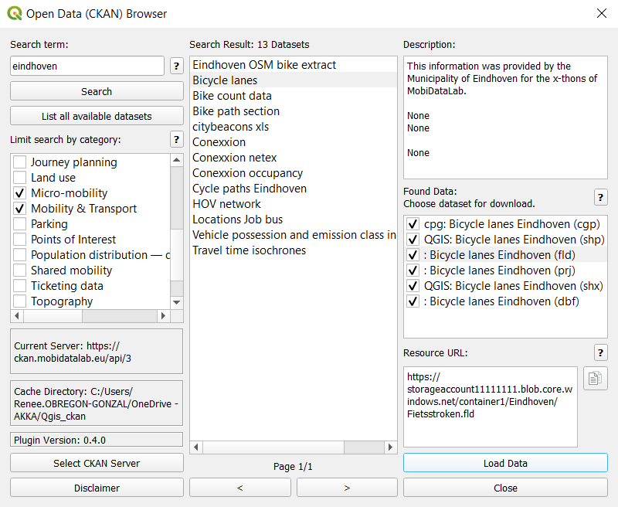
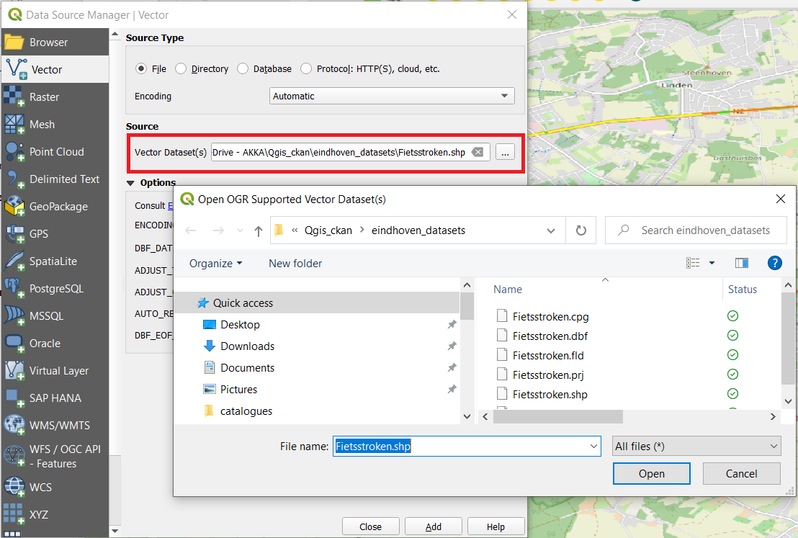
Load data from the CKAN browser
Load the data from the CKAN browser
If you downloaded the data, slide it into the Qgis project or add the layer via the “Layer” menu, select “Add Vector Layer” and search on the cache directory the downloaded shape file
Notes:
To load the data downloaded from the CKAN browser, it is possible to slide layers from the “Cache folder” into the Qgis project or add the layers via the “Layer” menu by selecting “Add Vector Layer” and searching on the cache directory for the d downloaded file. In the example below a shape file will be loaded.
An advantage of the MobiDataLab catalogues is that we have pre-filtered data, so all the datasets related to this project and reference groups are federated in only two portals, which makes data more accessible, findable and linkable.

Slide 26
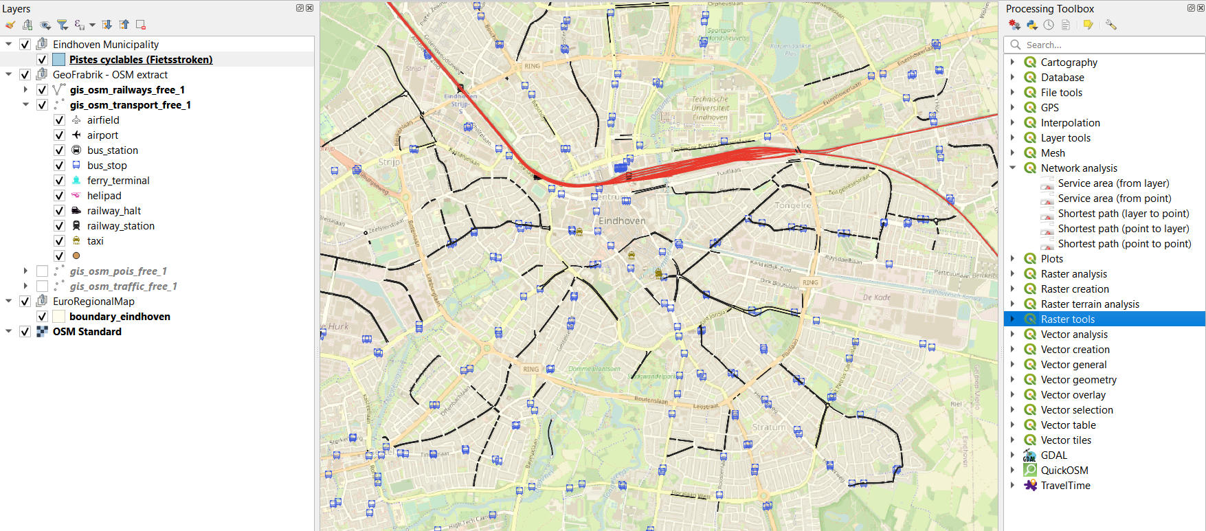
Processing Toolbox
Notes:
With this data, it is possible to analyze different use cases.
For example, to explore the datasets of the Municipality of Eindhoven, it is possible to display the safe cycling areas, train, bus and taxi stations.
This information can be analyzed with the processing tools of QGIS, so we can find if biking and riding is possible for people coming from outside the city or identify how accessible the city is for cyclists and people with reduced mobility in the city.

Slide 27
Plugins and other portals

Slide 28
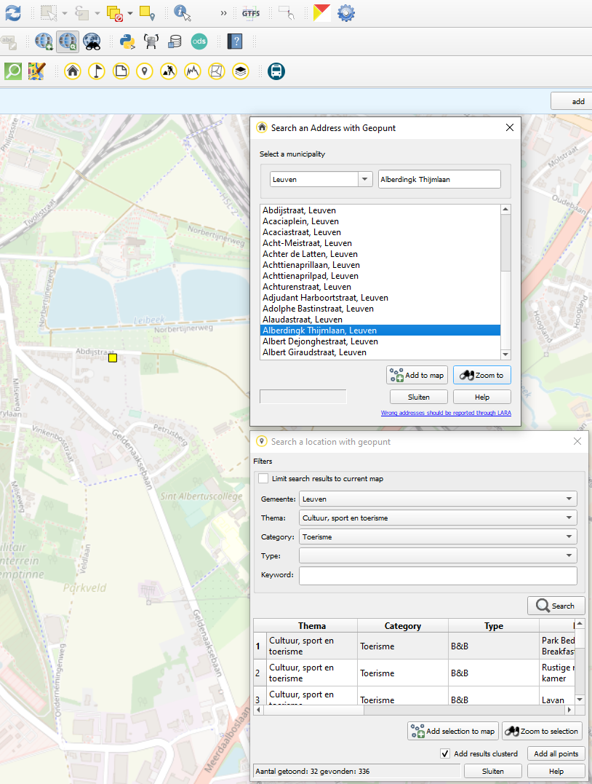
Flemish geoportal : geopunt4Qgis
Geopunt for QGIS is a plugin for the QGIS open source desktop GIS, which opens the web services of the Flemish geoportal Geopunt users. The Flemish Geoportal Geopunt offers several geographic services (web services) that may be used by third parties such as other governments and companies.
Geocoding [regular, batch and reverse] based on the address registry of Flanders
Search for POI in geopunt
Search for traffic obstructions in GIPOD
Draw elevation profiles
Search for Parcels
Search for layers in the geopunt catalog

Slide 29
GeoPortal.rlp Metadata Search
This plugin uses the REST search interface of GeoPortal.rlp for searching spatial datasets and services. It has also an option to search in remote CSW-based catalogues (e.g. in the INSPIRE Geoportal Catalogue and the German Geodatenkatalog.DE). WMS/WFS and OGC API Features interfaces can directly be loaded into the QGIS Browser.
All technical data can be found on Github : https://www.vlaanderen.be/geopunt/plug-ins/qgis-plug-in

Slide 30
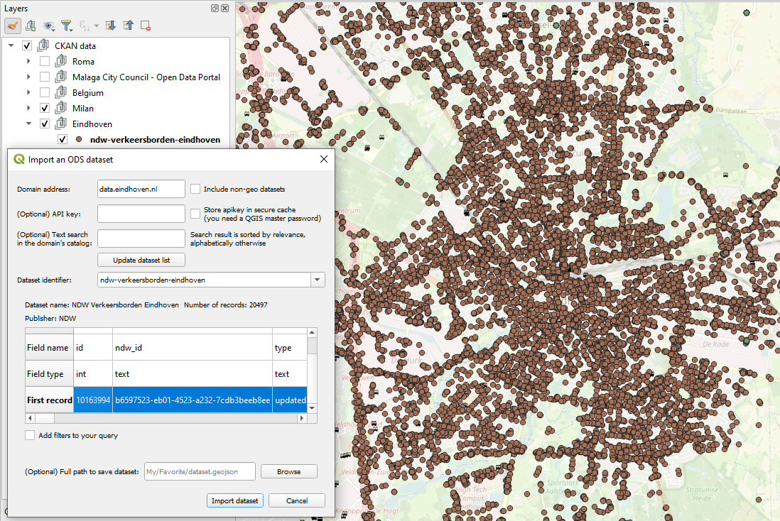
Opendatasoft plugin
Download datasets from Opendatasoft-powered data catalogues.
This plugin allows one to directly import, in the GeoJSON format, any dataset from a private or public Opendatasoft portal. It uses the web Explore API v2 to fetch the data, thus you will find this plugin in the web menu.
NDW transport information of Eindhoven

Slide 31
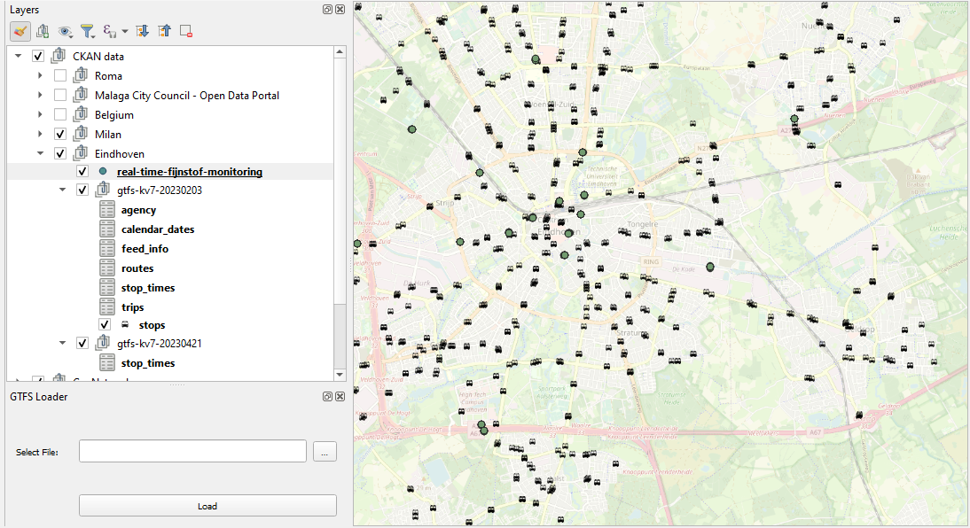
GTFS of transports in Eindhoven

Slide 32
Here Route API Plugin
Hqgis Routing, Geocoding, POI search, Isochrones with the HERE API.
Impact toolbox This plugin automates access to the ANYWAYS API by :
Taking a set of Points of Interest (POIs) and returning routings between all of them based on a given routing profile
Taking two sets of POIs as Origins and Destinations and returning routings from all origins to all Destinations based on a given routing profile

Slide 33
Other plugins to explore
Travel Time
Mobility Areas
PosiView
GBFS-NOW
QGIS Cloud Plugin
Networks
OpenTripPlanner
Tempus
MapTiler
QuickOSM
OSMDowloader
Pelias Geocoding
Valhalla
OSM place search
QBan(o)
AdressesFr
Google Maps geocoder
OS search for addresses
OS Translator II
GeoPortal.rlp Metadata Search
Qweather
XYZ Hub Connector : Connect QGIS to your personal space on HERE Data Hub and to your Interactive Map Layer inside the HERE Platform.
Greek Data

Slide 34

Thank you for listening
Renee Obregon, AKKODIS,
renee.obregon-gonzalez@akkodis.com

